Slide 1
Amazon Review Using Text Mining and Machine Learning
BY
AAKARSH NADELLA
PREM CHAND AVANIGADDA
BHAVANI PRASAD RAO EJANTHKAR

Slide 2
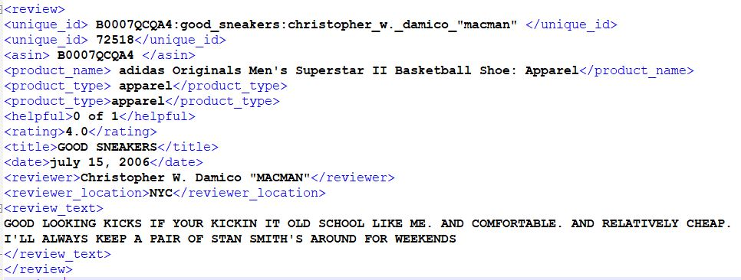
Dataset
Amazon Reviews (Text Data) - 5 GB, XML
Review - 25 Categories such as apparel, electronics, dvd, books, etc.
Positive Review, Negative Review

Slide 3
Pre-processing of Data
Retrieving review from XML files, enclosed in <review_text> tag
using xml.etree.ElementTree package
Encoded using utf - 8
Converting to a csv file appending class labels appropriately.
Cleaning the data
Removing special characters such as @,”, # and restricting the data only to alphanumeric characters (A-Z, a-z, 0-9).
Removing Stop words
Performing Stemming
Creating Bigrams

Slide 4
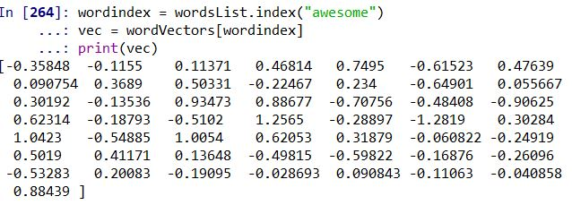
Creating Word Vectors
Assigning Vector Representation for each word
Word2Vec tool.
Used the pre-trained Word vector Model “GloVe”
400,000 word vectors with a dimensionality of 50.
Tokenizing all the data corpus and assigning indexes for each word according to GloVe and matching these with indexes.

Slide 5
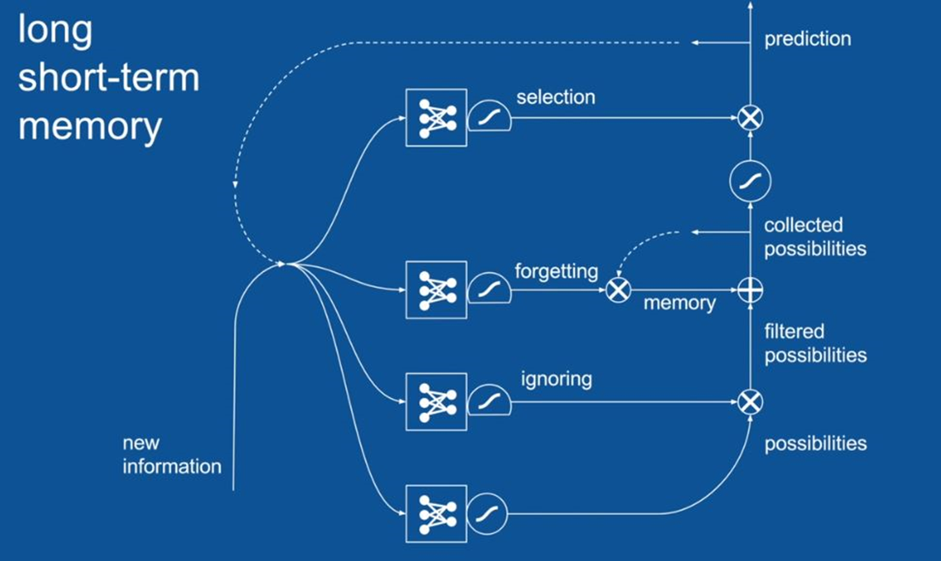
Recurrent Neural Networks

Slide 6
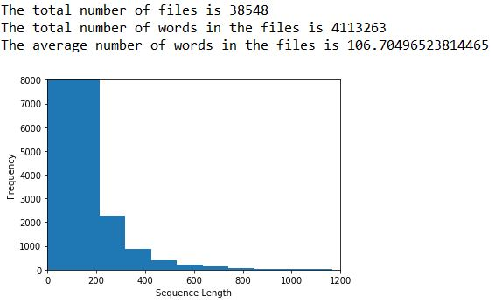
Building the model
maximum sentence size = 300
training set = 75%
testing set = 25%
input size = [trainrows, 300]
Word matrix = [300, 50]
learning rate = 0.001
iterations = 100,000
lstm units = 64
batchsize = 24

Slide 7
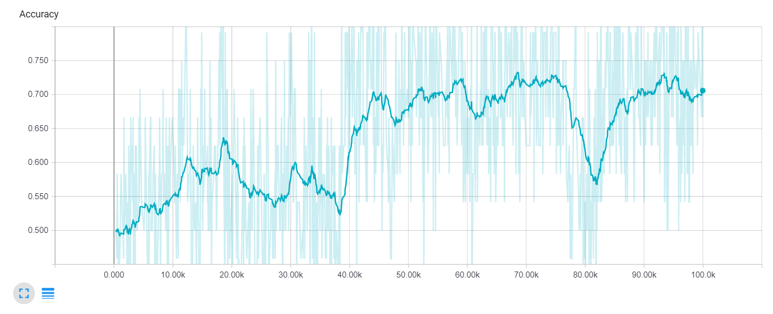
Accuracy - 100,000 iterations

Slide 8

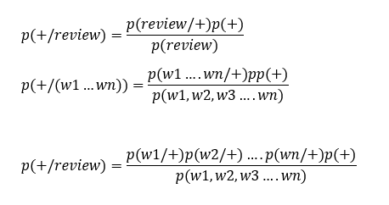
Naive bayes using nltk
bayes theorem
nltk- Natural Language ToolKit
bayes theorem applied to text classification

Slide 9
Naive bayes using nltk
Bigrams
It will help to capture the sentence structure
bigram_finder = BigramCollocationFinder.from_words(words)
bigrams = bigram_finder.nbest(score_fn, n)
return dict([(ngram, True) for ngram in itertools.chain(words, bigrams)])

Slide 10
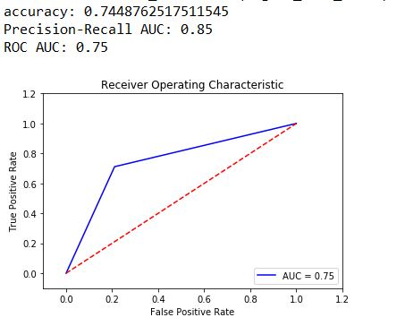
ROC curve for naive bayes

Slide 11
Results
Algorithm | Accuracy
Naive Bayes Classification | 68.5
RNN using LSTM | 70.83
Naive Bayes Classification with Bigrams | 74.4

Slide 12
REFERENCES
http://jmcauley.ucsd.edu/data/amazon/

